Slide 1
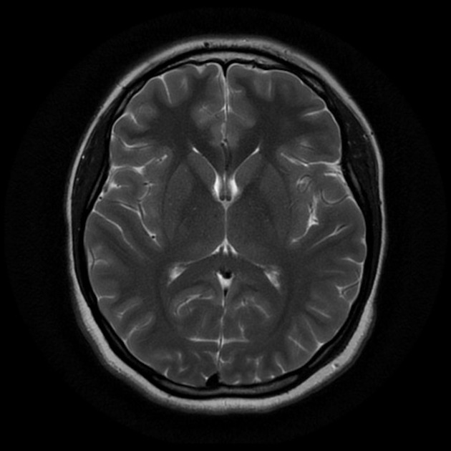
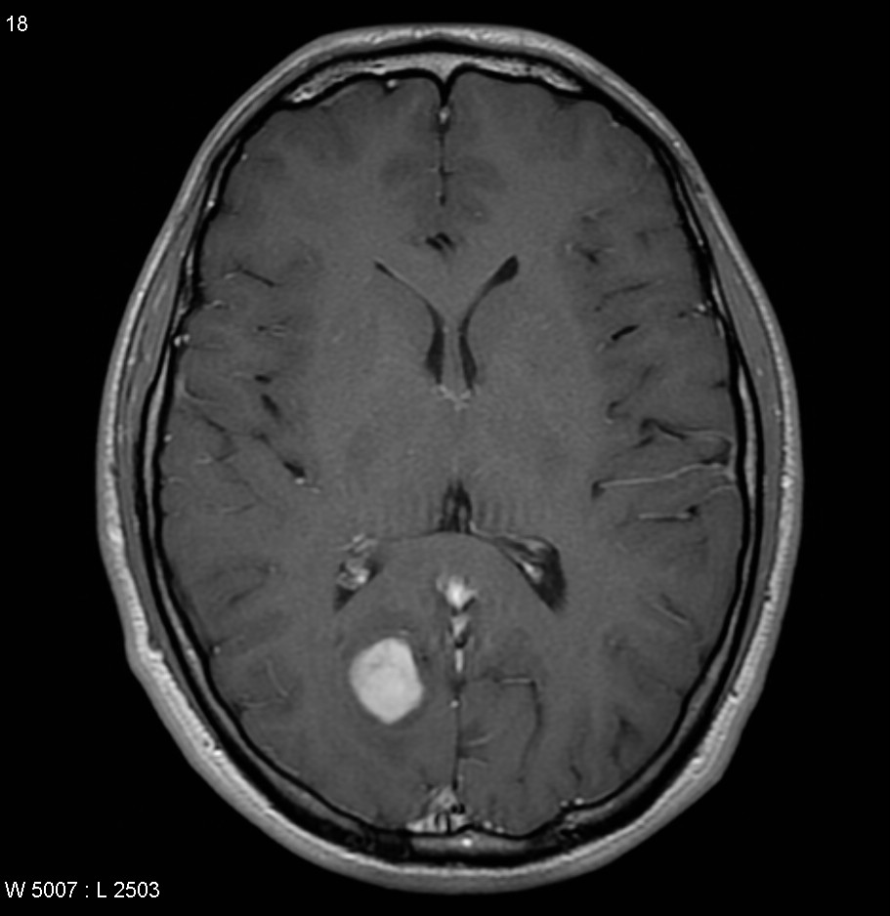
MRI Scan without a Tumour
MRI Scan with a Tumour

